Slide 1
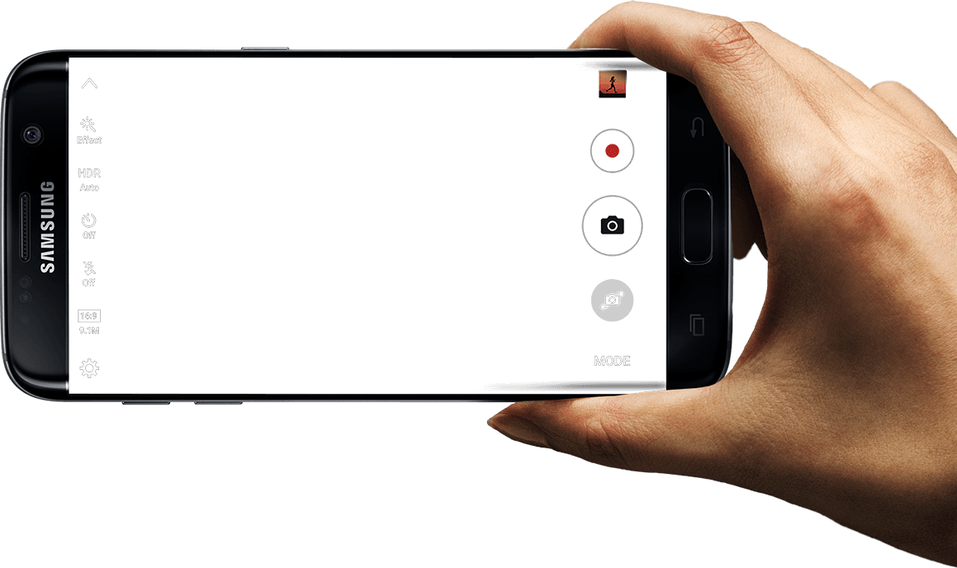
a
AR advertising
platform
senier project
201233295 권배식
201433457 이원상
201533651 안소현

Slide 2
Contents
Introduction
Architecture
Implementation
Marketing plan

Slide 3
INTRODUCTION

Slide 4
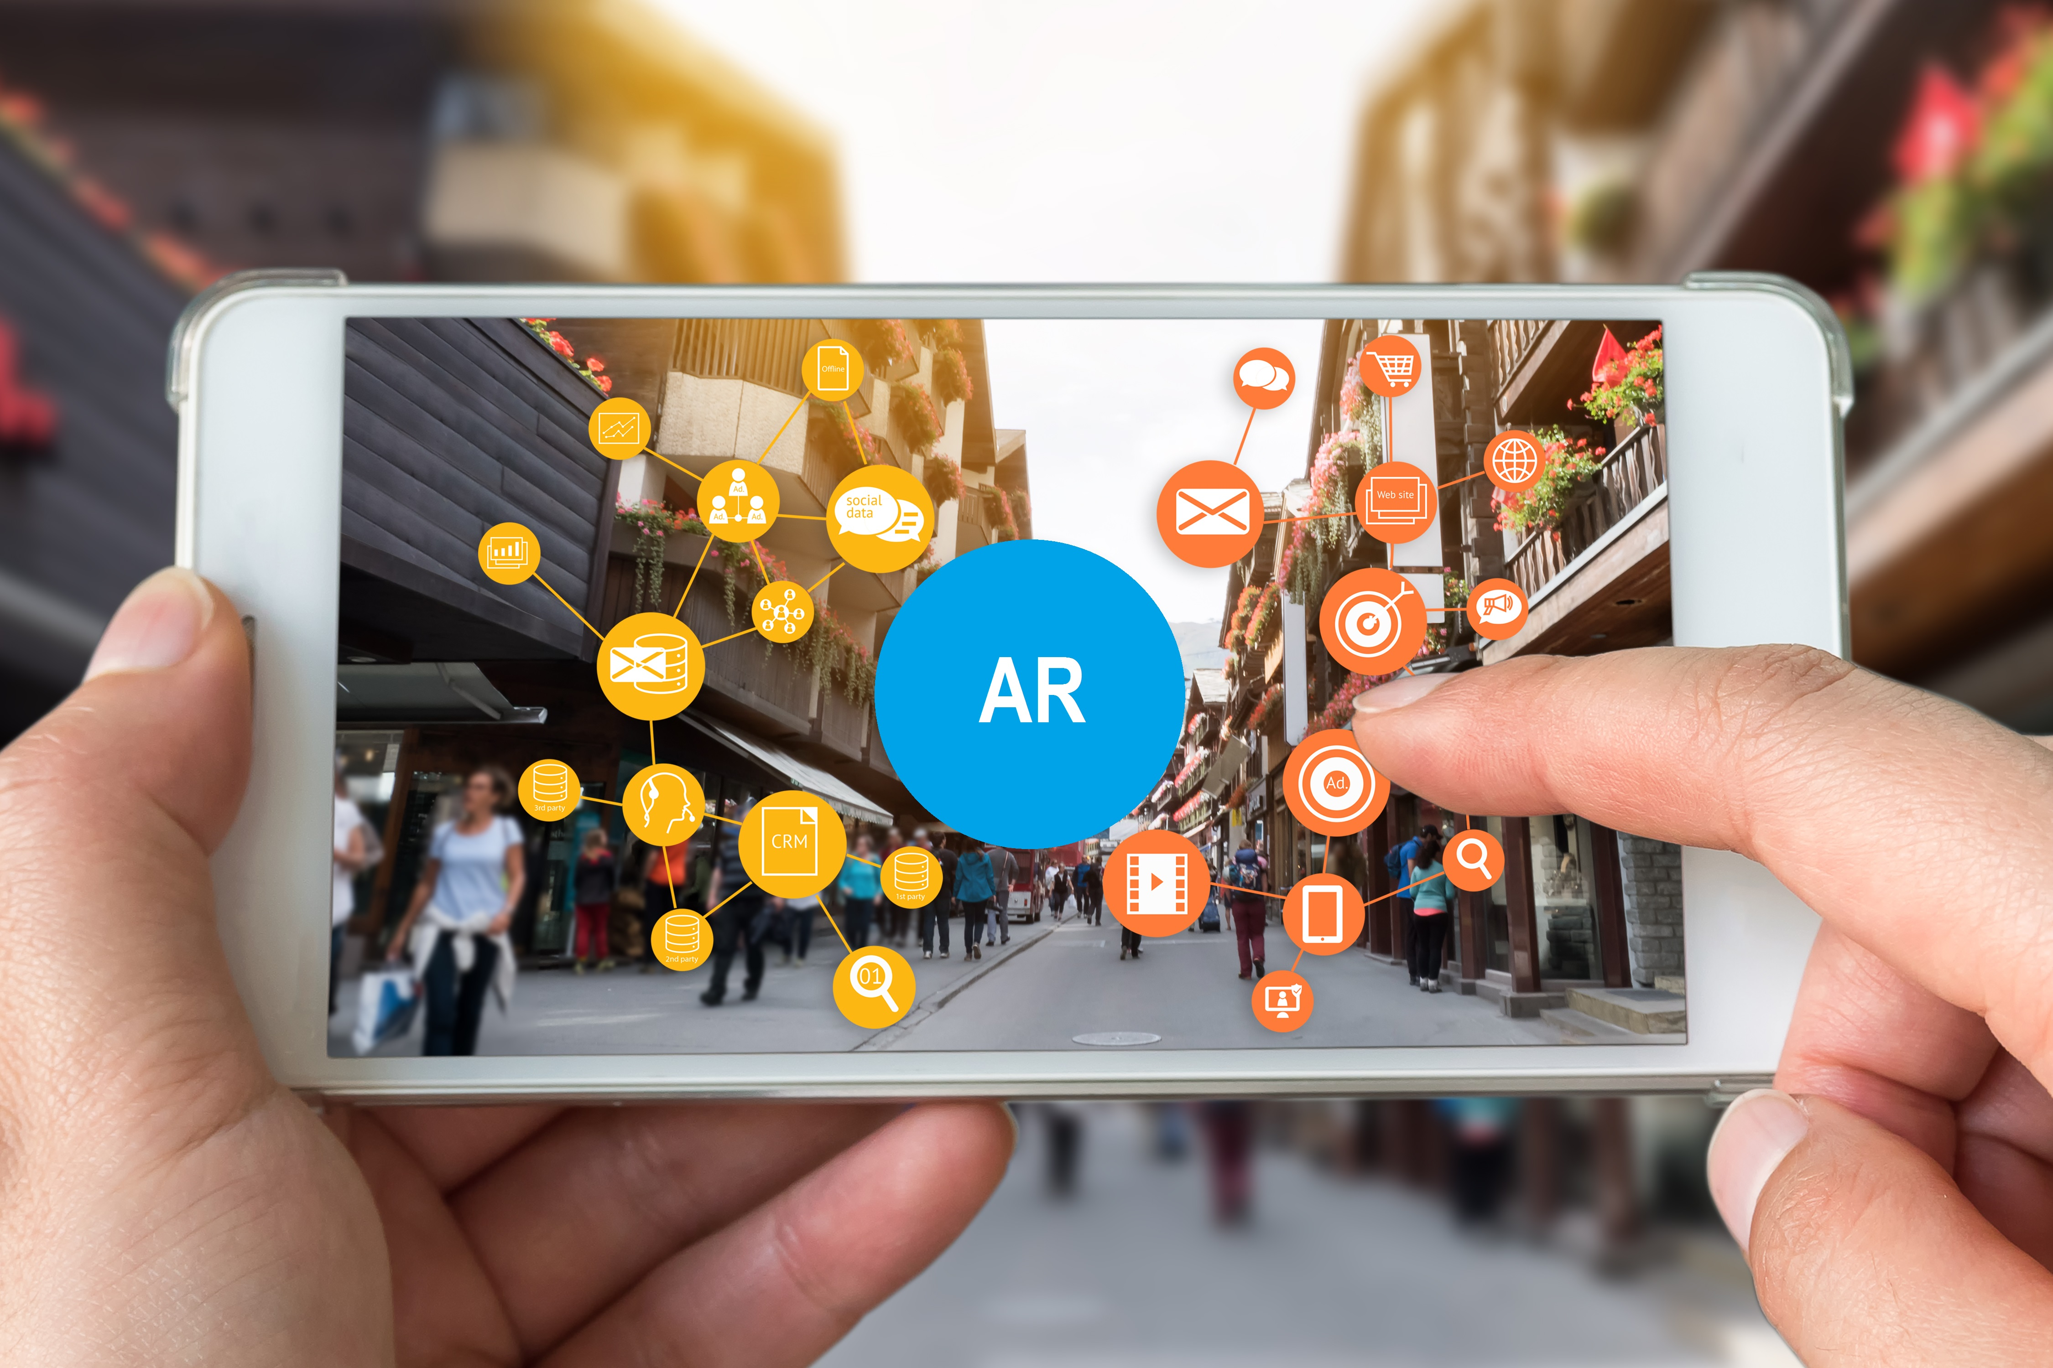
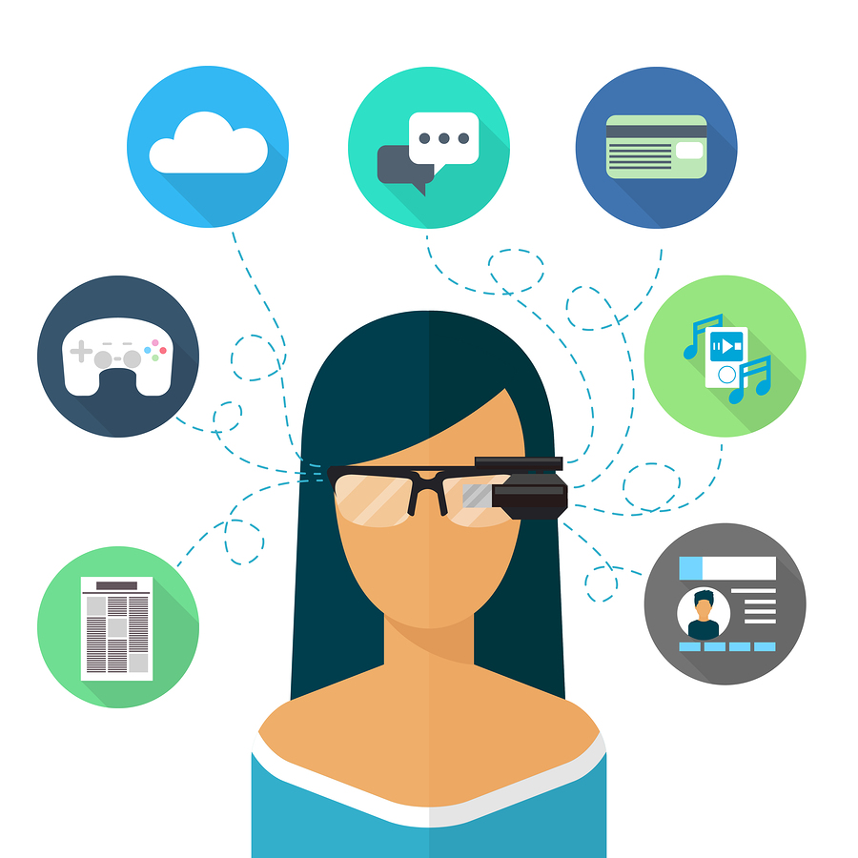
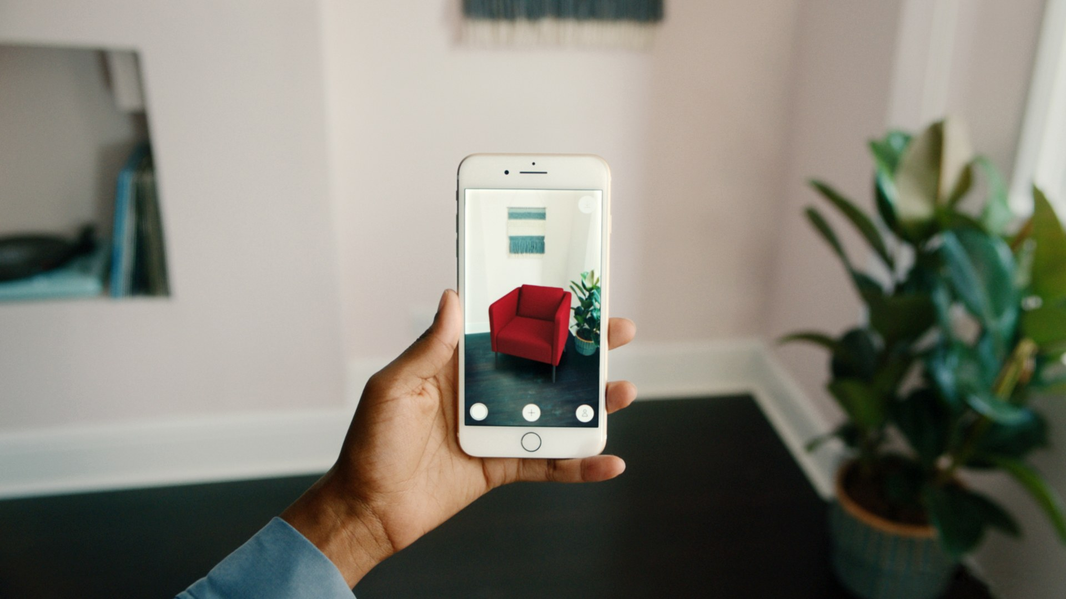
Introduction – What is AR?
Augmented Reality is refers to the addition of virtual to the status of reality.
In particular, augmented reality technologies are meaningful in that they can utilize existing images.
AR technology has been used in various fields such as broadcasting, games, medical care, exhibition, and public relations since the late 1990s. But, it did not produce good results.

Slide 5
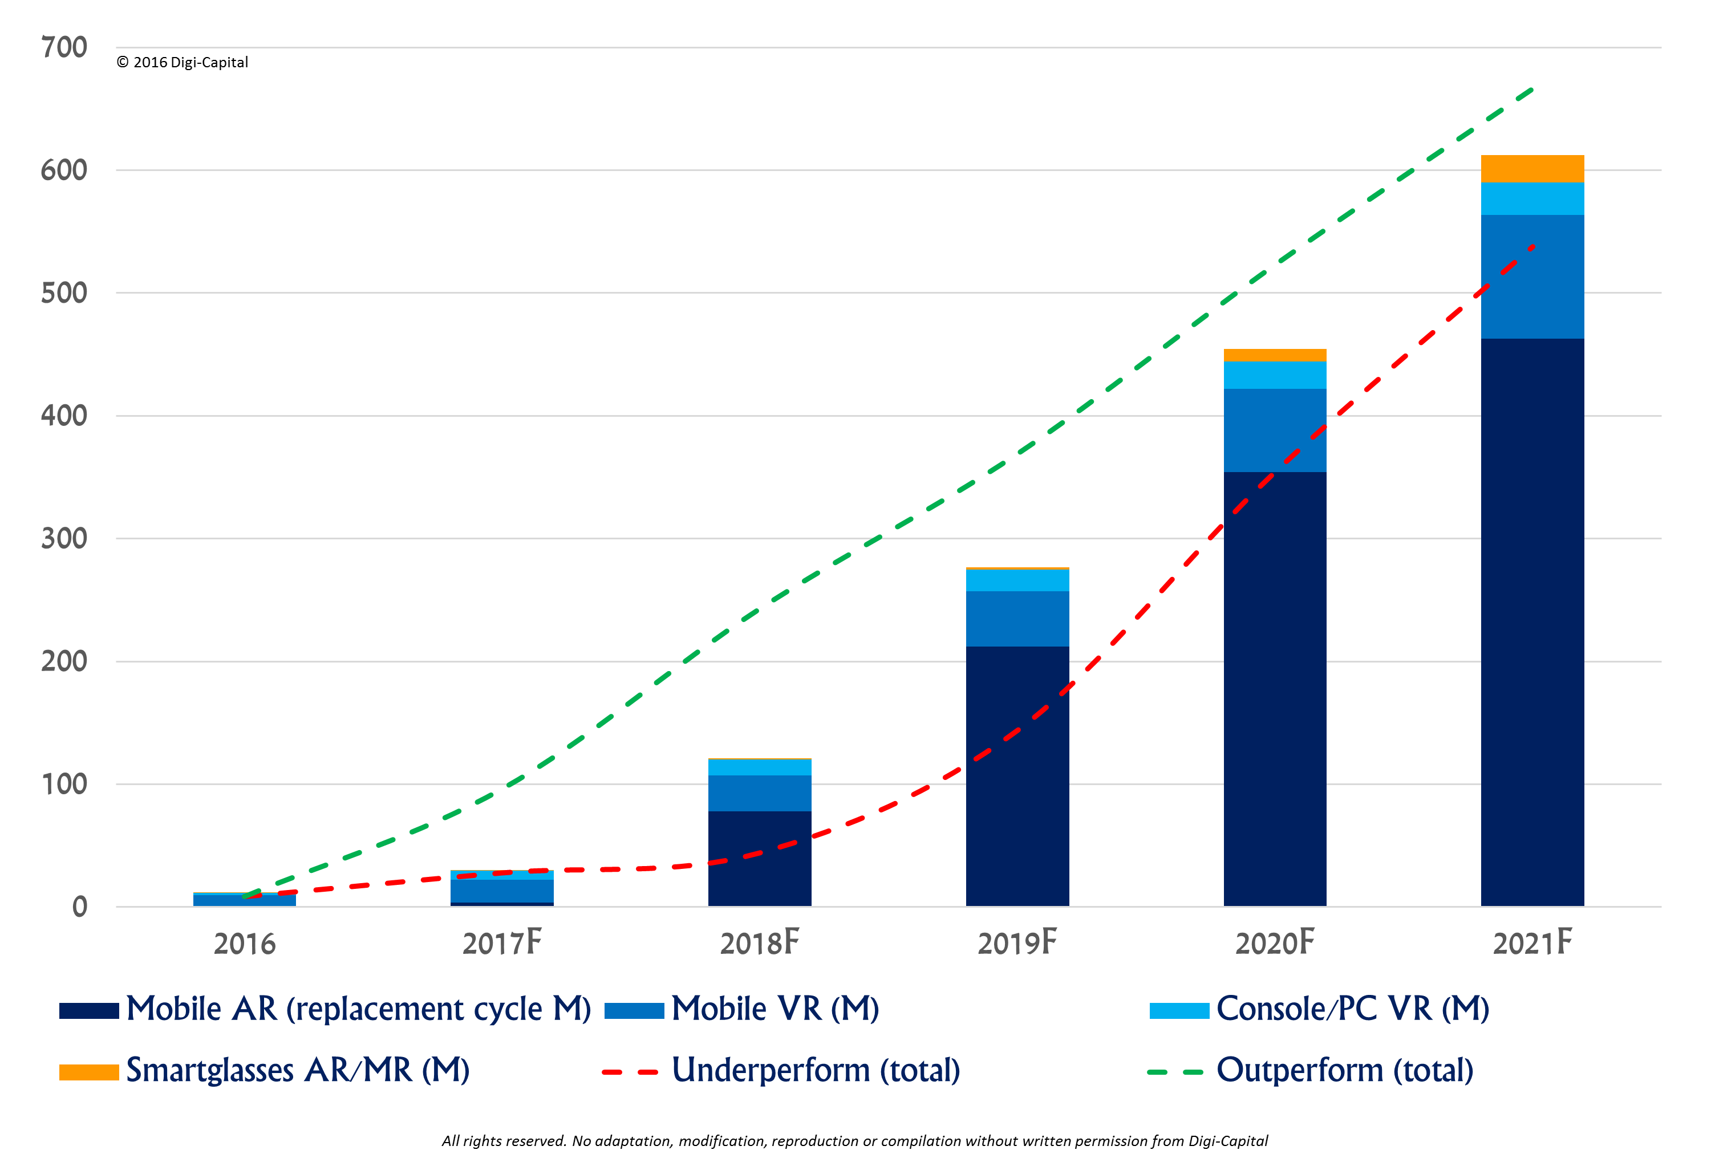
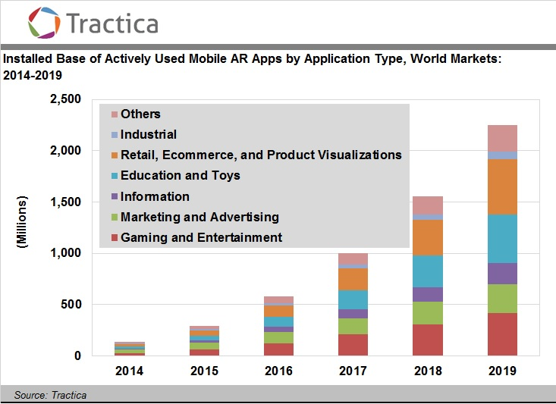
AR tech’s Rapidly growth
In other words, various AR services were started to be released, various types of AR contents were naturally produced, and a large amount of data was used as the AR contents were transferred locally.
As of 2016, when Pokemon Go was serviced, the size of the VR and AR markets is increasing rapidly.
VR/AR installed base (M). Source: Digi-Capital

Slide 6
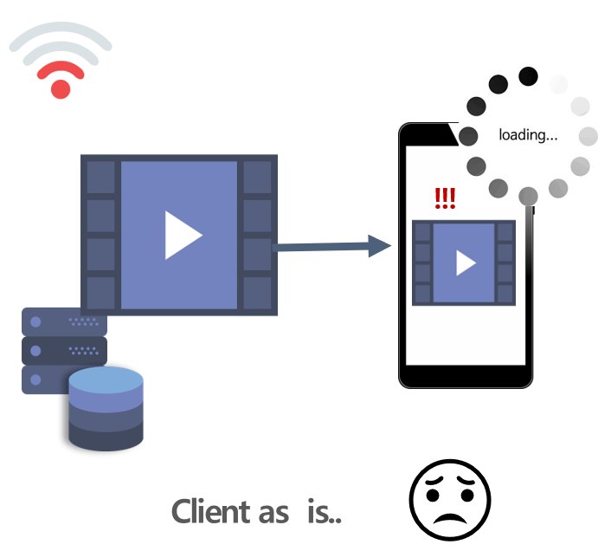
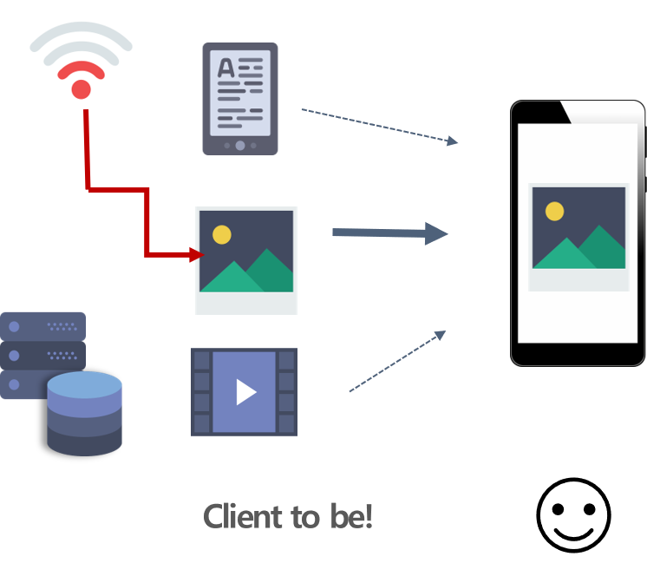
The problem of present environment
Most recent research on AR focuses on object recognition and content consumption.
Therefore, our project proposes a technology to deliver AR contents by minimizing communication delays.
So, this technology is expected to be used in various AR services.

Slide 7
ARCHITECTURE

Slide 8
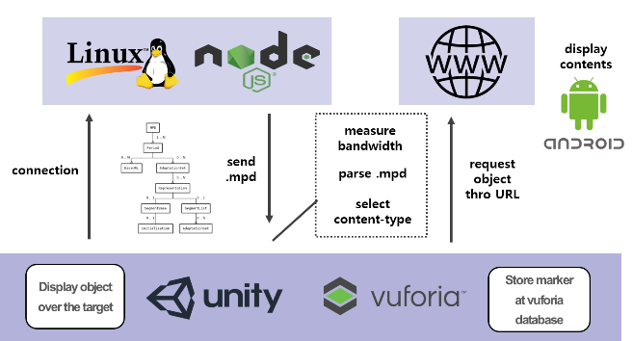
Architecture

Slide 9
Architecture
The content server contains a Media Presentation Description (MPD) that describes the details of the content as well as the images and images.
MPD describes appropriate content for network bandwidth and segment information for streaming for video.

Slide 10
Architecture
Users choose the content that is currently stored on the server that is appropriate for them by comparing their network bandwidth with the bandwidth described in MPD.
AR object recognition used Unity 3D plug-in provided by Vuforia. Here, Vuforia is the most widely used AR platform that can be recognized from images to 3D and multI-target.

Slide 11
Architecture
When an object is recognized by the device, the server passes the object information to the server and the mpd file mapped to the object is passed.
The client downloads the mpd file, measures the bandwidth, and parses the delivered mpd to determine the bandwidth criterion for each content.
You can choose the type of content that you measure according to the bandwidth criteria. Once a content type is selected, it is connected to the url contained in mpd and displayed that content

Slide 12

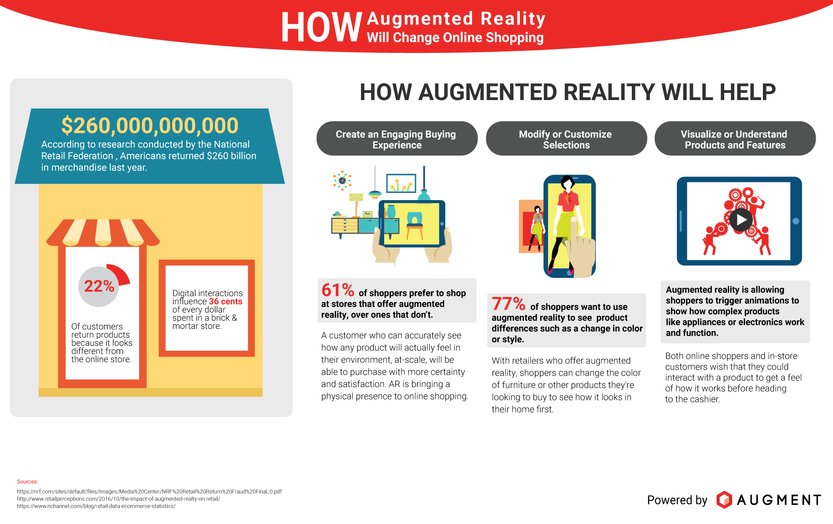
scenario
When the user recognizes the recognition object, the content server is accessed through the DNS server, and the server transmits the MPD to the user
The user device receiving the MPD calculates the bandwidth of the current network using the size of the MPD and the time taken for the transmission.
After comparing the measured bandwidth with the bandwidth described in the MPD, the content server requests the most appropriate content according to the current user's network situation.

Slide 13
IMPLEMENTATION

Slide 14


- DEMO
Implementation
Recognize objects one by one
Recognize objects at once
* Why is cider an image?
When downloading several contents at the same time, it is judged that the download bit rate of the contents of the late recognized object is lowered.

Slide 15
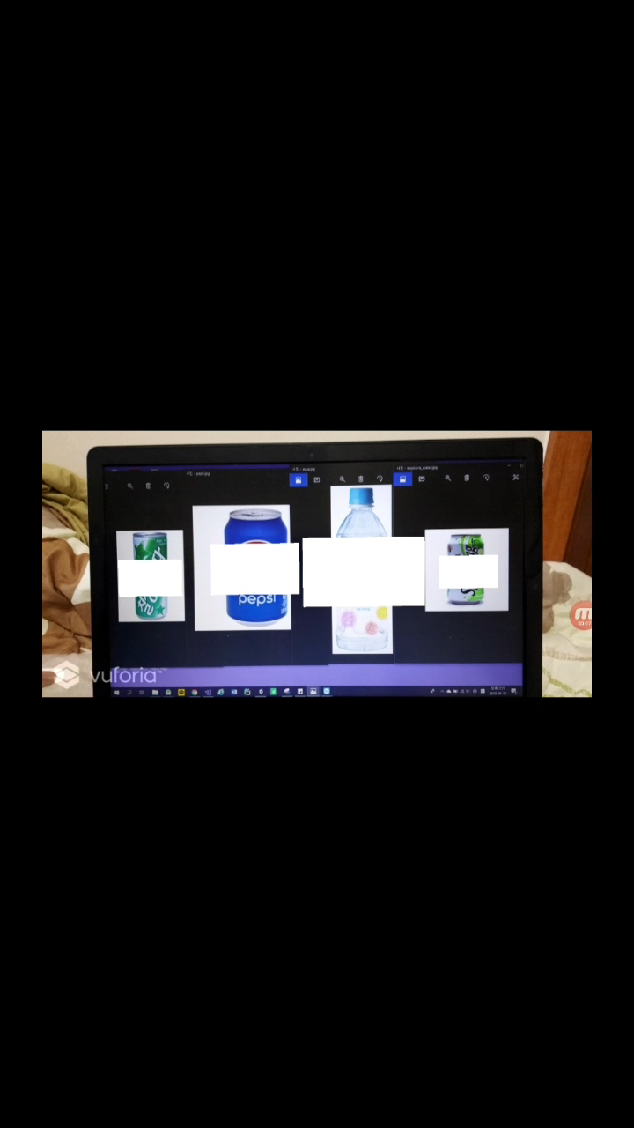
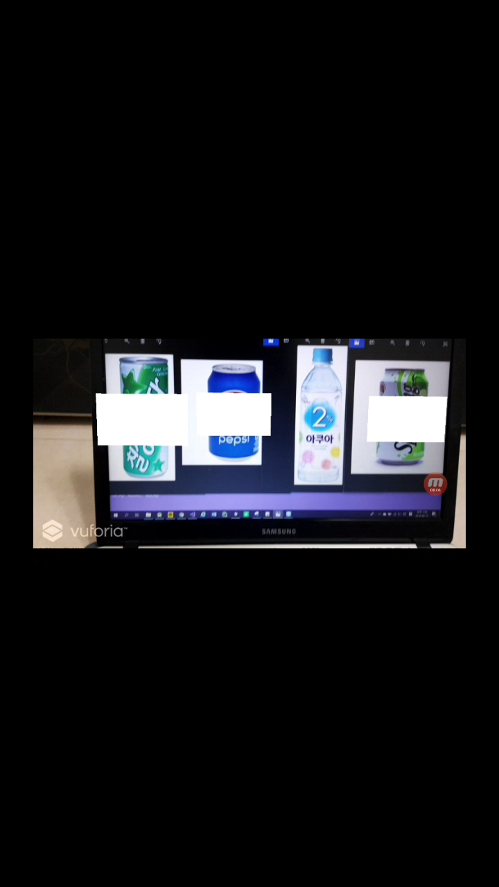
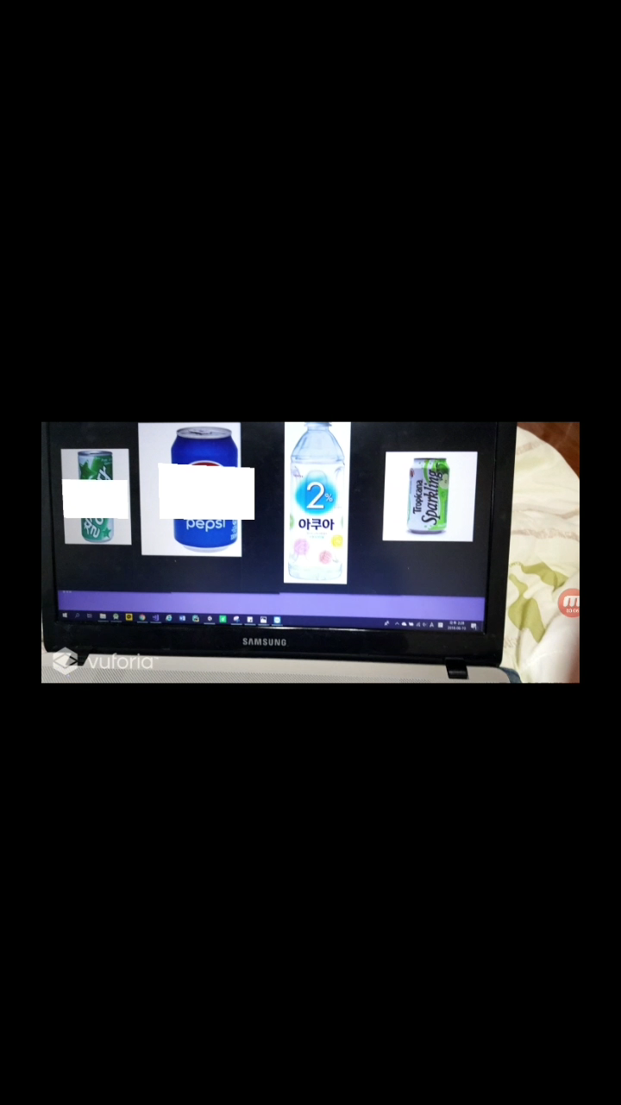
- Time to load all content
Implementation
< road only video >
about 2.48sec
< Ours > about 1.58sec
< road only Image >
about 0.24sec

Slide 16
Content selection criteria
Implementation
When downloading the mpd file containing the information of the content from the server, the download bit rate is measured.
At this time, mpd file has a bandwidth for selecting a video and a bandwidth for selecting an image. The bandwidth is determined by parsing the bandwidth.
<AdaptationSet segmentAlignment="true" maxWidth="1920" maxHeight="1080" lang="eng">
<Representation id="2" mimeType="image/jpeg" width="400" height="300" bandwidth="3000">
<BaseURL>toreta_img.jpg</BaseURL>
</Representation>
</AdaptationSet>
*In the demo video, the bandwidth standard was unified as follows
Video 100000bps/sec
Image 3000bps/sec

Slide 17
Problem (Limit)
Implementation
The capacity of the Mpd file is so small that it may not be suitable for measuring bandwidth.
Why use ‘mpd’ to measure bandwidth?
When using the bit-rate of image download, it is not suitable for measurement because it has a smaller capacity, like the limit of mpd.
When using the bit-rate of the video download, it is judged that the overhead is large when it is measured as non-trade which can obtain the desired bandwidth but is not suitable for playing the video and the image download must be applied even though the video has already been downloaded.

Slide 18
MARKETING PLAN

Slide 19
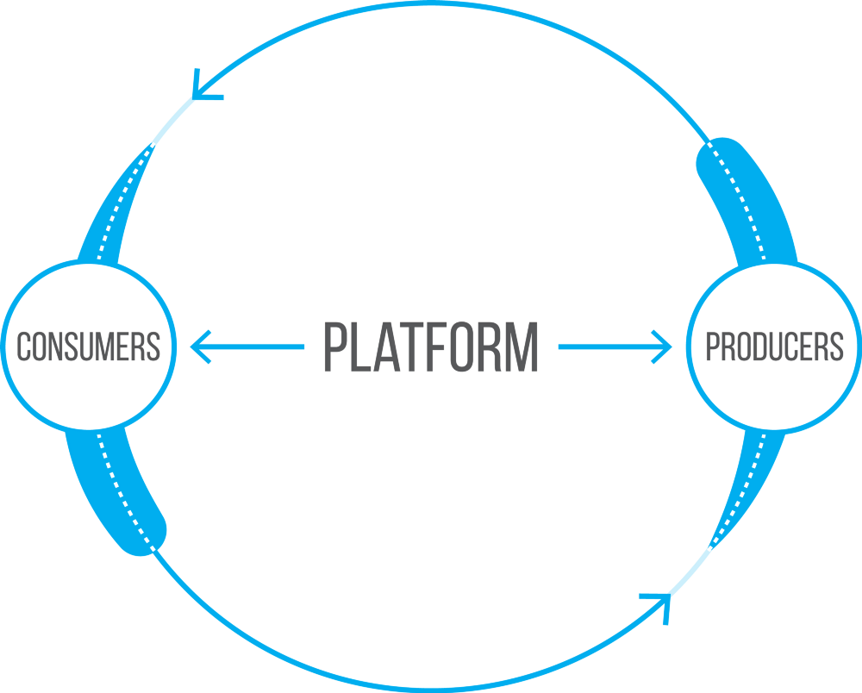
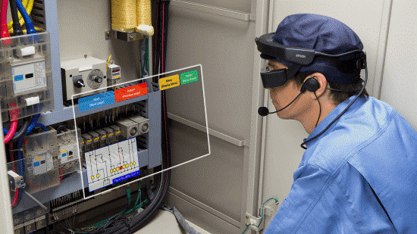
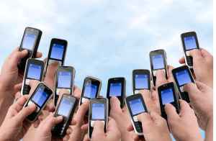
Profit Structure
Our solution is...
education
can be utilized as various AR service technologies
So, expected to be universally used in various multimedia streaming fields
Brokerage fees
advertising fees
licensing
Industrial
OUR
contents
marketing
Mobile users
Game

Slide 20
Platform build strategy
▶ Form of sales
Providing AR content
▶ Killer Service
Companies do not have to create AR applications
Add easy contents
Provide content even when network conditions are not good
Available to all Android users
▶ Two-sided market composition
Collaboration with content providers

Slide 21
SWOT Analysis
S
O
Considering bandwidth only
Lack of AR advertising contents
Lack of infrastructure
Most AR-related research has focused on object recognition
Can be used in various fields
Not familiar to the public
providing optimal contents depends on environment
W
The size of AR market is huge enough
T

Slide 22
Examples of use
Advertisement
platform
Energy monitoring platform
Brand advertising effects can be expected. You can tell the effectiveness of advertising and information on a product if you do not enter the store and show what product you want.
For example, if you shine a refrigerator, you can see the current energy efficiency of the refrigerator, and if you shine another battery, you can use the remaining energy visually

Slide 23
END

Slide 24
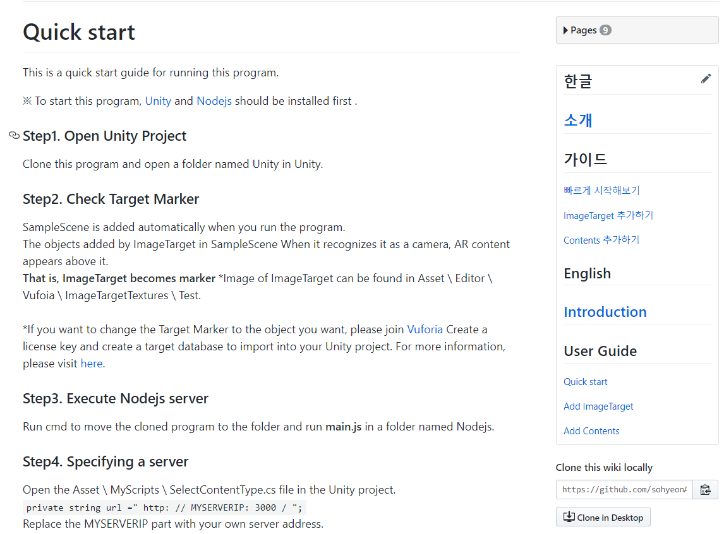
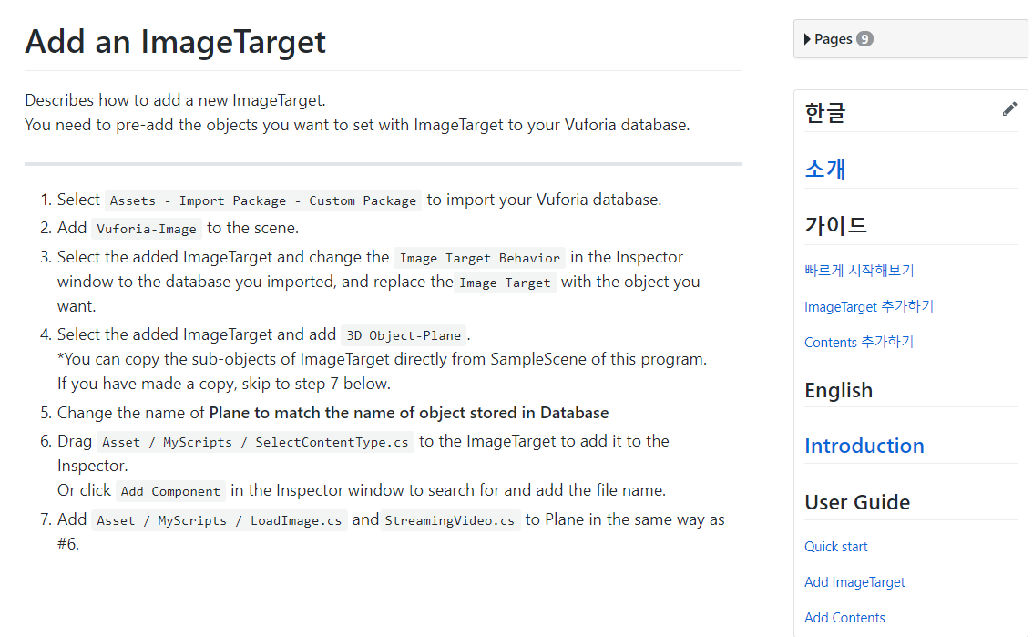
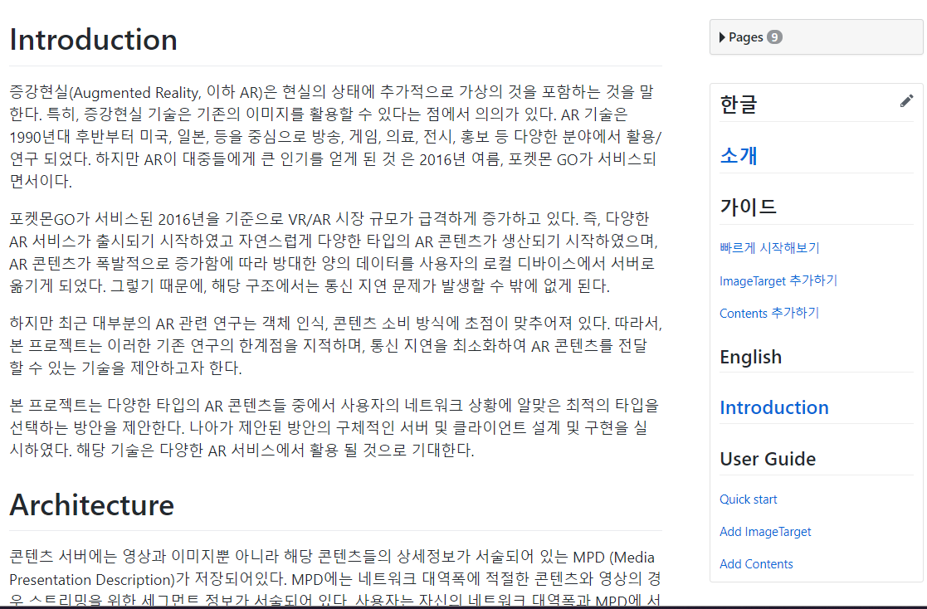
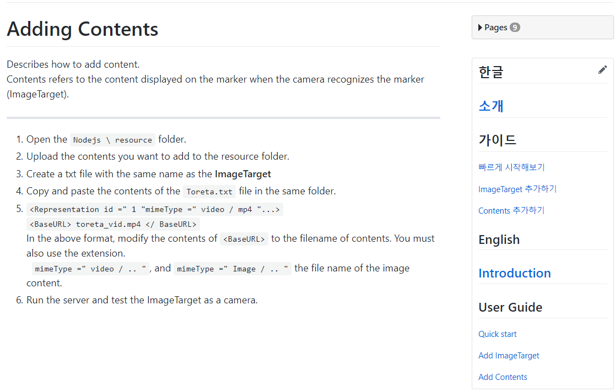
Link
Github WIKI
https://github.com/sohyeonAn/CapstoneDesign-smart-AR-platform

